Slide 1


LESSON 4
SOLUTIONS OF OBLIQUE TRIANGLES

Slide 2
OBLIQUE TRIANGLES
Solving a triangle involves finding the lengths of all sides and the measures of all angles in the triangle. In this lesson, we will discuss the solutions of oblique triangles, which are triangles that does not contain a right angle. There are two laws we can use in solving oblique triangles, the Law of Sines and Law of Cosines.
Law of Sines can be used to solve oblique triangles in which either two angles and a side are known or two sides and an angle opposite one the sides are known.
Law of Cosines can be used to solve oblique triangles in which two sides and the included angle are known or in which three sides are known.
Notes:
Week 3 rbteodoro_06@yahoo.com

Slide 3
Solution of oblique triangles involves four cases, namely:
Two angles and one side are given.
Two sides and the angle opposite one of the sides are given.
Two sides and the angle between those sides are given.
Three sides are given.
Note:
The Law of Sines is applicable for the first two cases and the Law of Cosines for the last two cases.

Slide 4
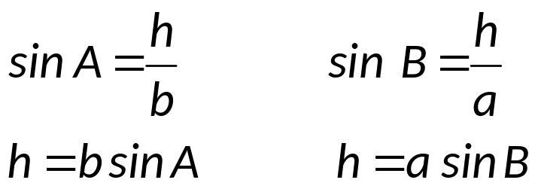
LAW OF SINES
Derivation of the Law of Sines
Let ABC be an oblique triangle with sides a, b, and c opposite their respective angles as shown in the figure below. If an altitude h is drawn to the base, we can write the following relationship:
C
b
a
h
A
B
c

Slide 5

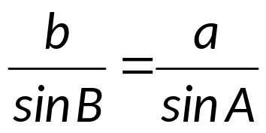
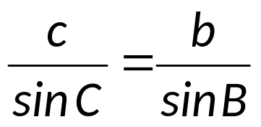
Equating the two expressions for h gives
Dividing both sides of the equation by sin A sin B gives the following relationship:
Similarly, if we draw an altitude from angle A to side a, we can derive the following expression:
Combining these two results gives the Law of Sines, summarized as follows.

Slide 6
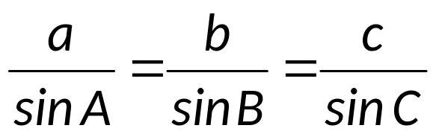
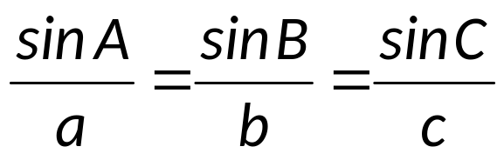
LAW OF SINES
If A, B, and C are the measures of the angles of a triangle and a, b, and c are the lengths of the sides opposite those angles respectively, then
The Law of Sines may also be written as,
In words, the Law of Sines may be stated as follows: The sides of a triangle are proportional to the sines of the opposite angles.

Slide 7
Case I: Two angles and one side are given.
Example: Solve the following triangles.
A = 51.3⁰ B = 48.7⁰ a = 24.5
A = 41⁰ B = 57⁰ c = 52
B = 119⁰ C = 21⁰ b = 59
Case II: Two sides and the angle opposite one of the sides are given. (AMBIGUOUS CASE)
When two sides and the angle opposite one of them are given, there may be no, one, or two solutions to the triangle. For this reason, Case II is called the ambiguous case. The following are the summary of the possible situations.

Slide 8
I. If A is an acute angle and a < b, there are four possible situations.
C
C
a
b
a=h
b
h
A
A
c
B
1) a < h; no triangle
2) a = h; one triangle
C
C
b
b
a
a
h
a
A
A
c
B
B’
B
3) h < a < b; two triangles
4) a ≥ b; one triangle

Slide 9
II. If A is an obtuse angle, then there are two possible situations.
C
C
a
a
b
b
A
A
c
B
1) a ≤ b; no triangle
2) a > b; one triangle

Slide 10
EXAMPLE:
Determine how many solutions exist. When either one or two solutions exist, solve the triangle or triangles.
Triangle ABC: A = 67⁰ a = 18 b = 20
Triangle RST: R = 87⁰ r = 47 s = 50
Triangle DEF : D = 32⁰ d = 7 e = 10
Triangle LMN: L = 113⁰ l = 49 m = 54
Triangle XYZ : X = 108⁰ x = 54 y = 51
Notes:
plane

Slide 11
Application:
The distance between an aircraft carrier and a Navy destroyer is 7620 ft. The angle of elevation from the destroyer to the helicopter is 77⁰, and the angle elevation from the aircraft carrier to the helicopter is 59⁰. The helicopter is in the same vertical plane as the two ships, find the distance from the helicopter to the aircraft carrier.
Two fire lookouts are located on mountains 20 miles apart. Lookout B is at a bearing of S65⁰E from lookout A. A fire was sighted at a bearing of N50⁰E from A and at a bearing of N8⁰E from B. Find the distance of the fire from lookout A.
A telephone pole 35 feet high is situated on an 11⁰ slope from the horizontal. The measure of angle CAB is 21⁰. Find the length of the guy wire AC.
Notes:
plane

Slide 12
LAW OF COSINES
DERIVATION OF LAW OF COSINES
Let ABC be an oblique triangle with sides a, b, and c opposite their respective angles as shown in the figure below. The altitude BD is drawn from B perpendicular to the x-axis. The triangle BDA is a right triangle, and the coordinates of B are (a cos C, a sin C). The coordinates of A are (b, 0). Using the distance formula, we can find distance c.
y
B(a cos C, a sin C)
a
c
C
A(b, 0)
x
D
(0, 0)
b

Slide 13
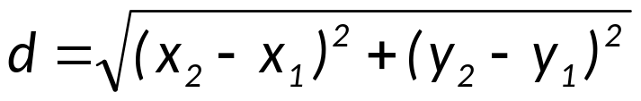
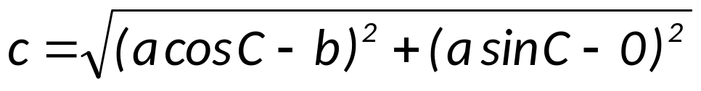

Using the distance formula:
But, sin² C + cos² C = 1. Therefore, one form of the Law of Cosines is .
Using the same method by changing the positions of the angles with their respective opposite sides gives similar results and summarized as follows.

Slide 14
LAW OF COSINES
If A, B, and C are the measures of the angles of a triangle and a, b, and c are the lengths of the sides opposite these angles, then
c² = a² + b² – 2ab cos C
a² = b² + c² – 2bc cos A
b² = a² + c² – 2ac cos B

Slide 15
Case III: Two sides and the angle between those sides are given.
Example: Solve the following triangles.
a = 18.4 c = 26.3 B = 47.9⁰
C = 115⁰ a = 11 b = 21
Case IV: Three sides are given.
Example: Solve each triangle ABC.
a = 11 b = 14 c = 17
a = 23 b = 43 c = 31

Slide 16
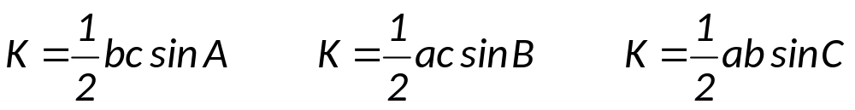
The Area of a Triangle
The area K of any triangle ABC is given by one of these formulas:
The above formulas are used to find the area of a triangle when the measures of the two sides and the included angle are known.

Slide 17
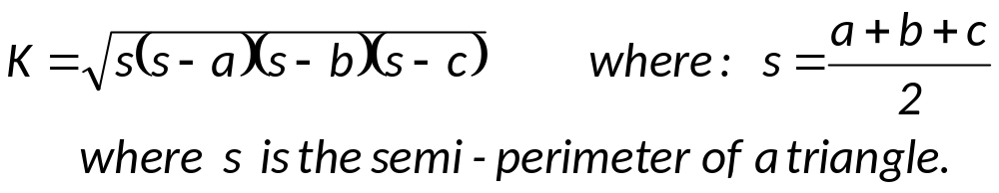
HERON’S FORMULA: If a, b, and c are the measures of the sides of a triangle, then the area K of the triangle is given by
Heron’s Formula is used to find the area of a triangle when three sides are given.
EXAMPLE: Find the area of the given triangle.
B = 71⁰ a = 21 c = 87
a = 31 b = 23 c = 14

Slide 18
Application:
A developer owns a triangular lot at the intersection of two streets. The streets meet at an angle of 72⁰, and the lot has 300 feet of frontage along one street and 416 feet of frontage along the other street. Find the length of the third side of the lot.
A plane leaves airport A and travels 560 miles to airport B at a bearing of N32⁰E. The plane leaves airport B and travels to airport C , 320 miles away at a bearing of S72⁰E. Find the distance from airport A to airport C.
A plane flew 180 miles at a heading of 108⁰ and then turned to a heading of 125⁰ and flew another 225 miles. Find the distance and the bearing of the plane from the starting point.

